Slide 1

Recommendations for Distribution of Funding During the 2025-2026 Fiscal Year
Sylvia Umegbolu
Data Analyst, World Solutions

Slide 2
Agenda
Business Problem
Methodology
Results of Global GDP Analysis
Conclusions
Areas for Further Study

Slide 3
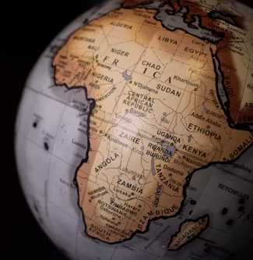
World Solutions is planning for the 2025-2026 fiscal year and is looking to understand investments it can make to support economic growth in Africa.
Specifically, World Solutions is hoping to understand which countries are performing the best and worst economically and how this information can guide their future grant-making strategy.
Business Problem

Slide 4
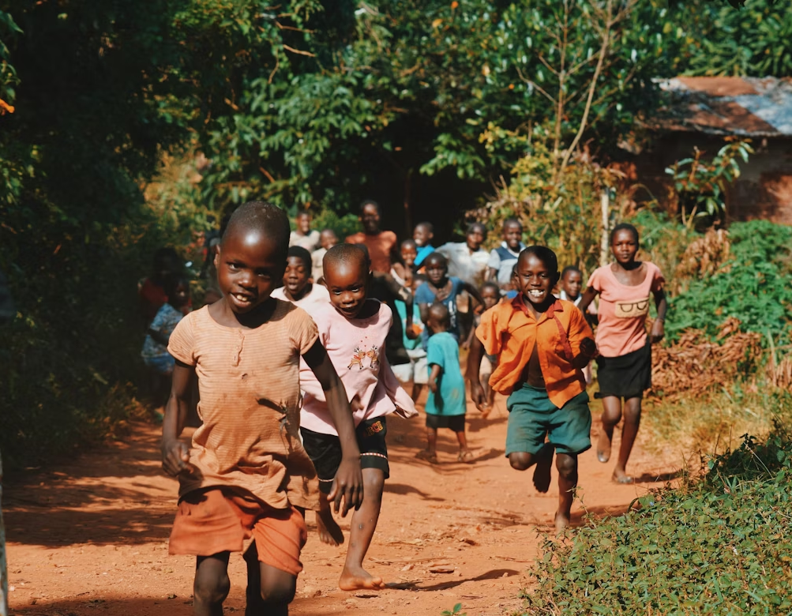
The Penn World Table provides various economic indicators that can be used to understand the current economic standing of countries around the world. This can be a great resource to make decisions on the investment options in Africa.
Dataset of Interest
Indicators of Interest
Variable | Definition
countrycode | 3-letter ISO country code
country | Country name
year | Year
rgdpe | Expenditure-side real GDP at chained PPPs (in mil. 2017US$)
rgdpo | Output-side real GDP at chained PPPs (in mil. 2017US$)
pop | Population (in millions)

Slide 5
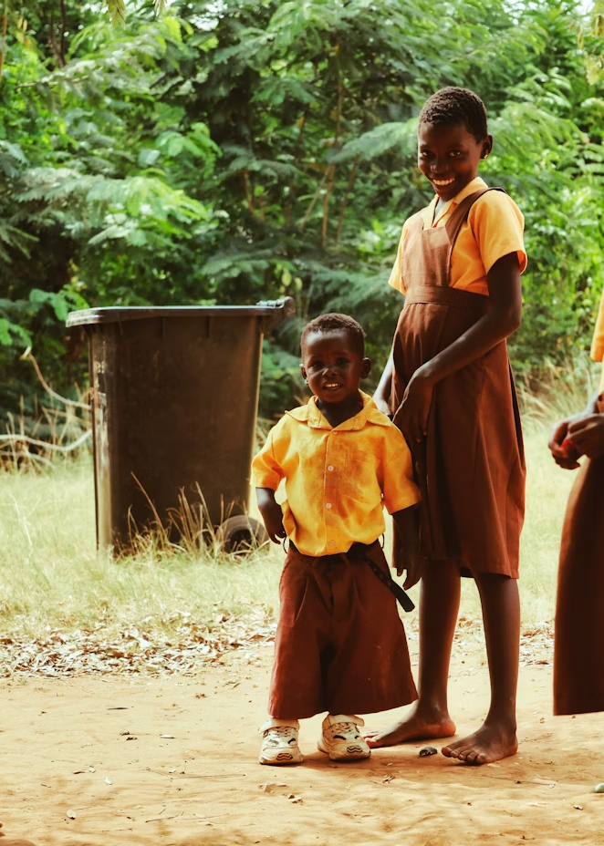
We will follow the following methodology to get insights on this data set:
Methodology
Data Cleaning
Filter the dataset so that we have the subset for Africa only
Remove unnecessary columns
Data Analysis
Find the average GDP for each country for the duration of the dataset
Graph the GDPs for the top 5 and bottom 5 countries over time
Calculate the average GDP for each country over the last decade only (2010-2019 in this dataset)
Calculate the GDP per capita for each country over the last decade only

Slide 6
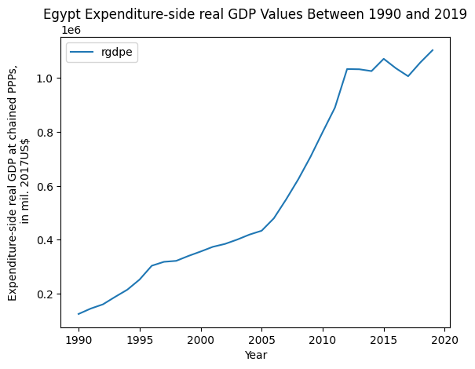
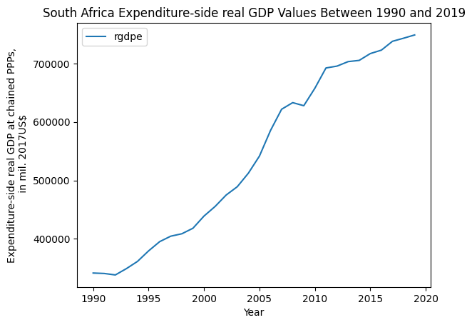
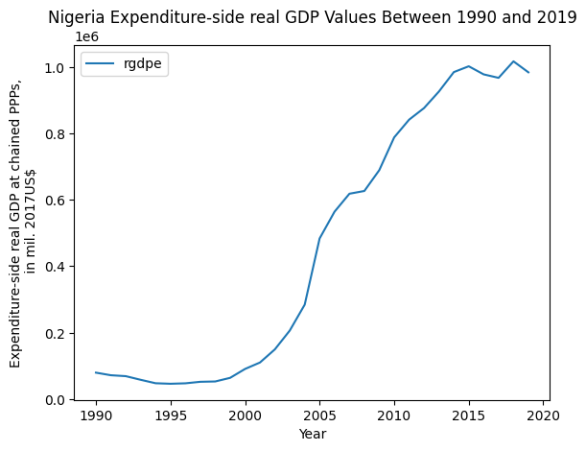
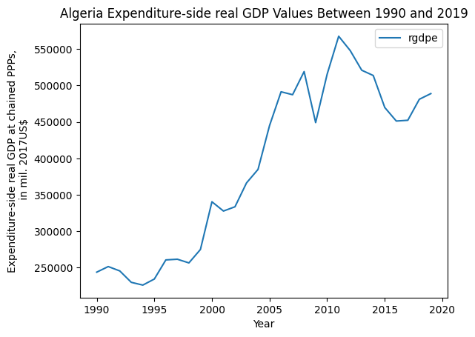
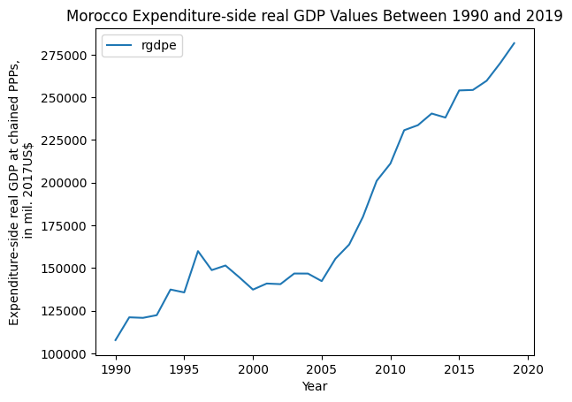
Results of GDP Analysis
The countries with the highest average GDP over the last 30 years are Egypt, South Africa, Nigeria, Algeria, and Morocco.

Slide 7
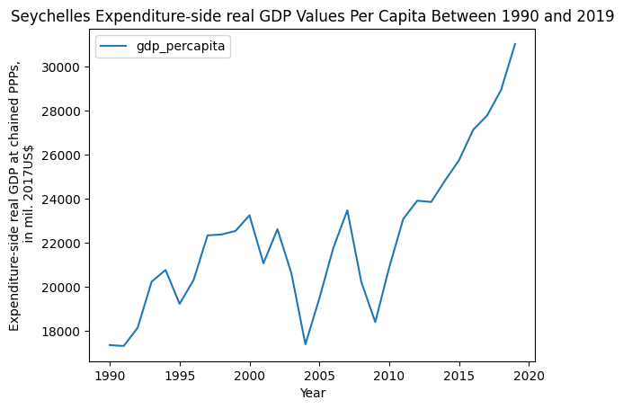
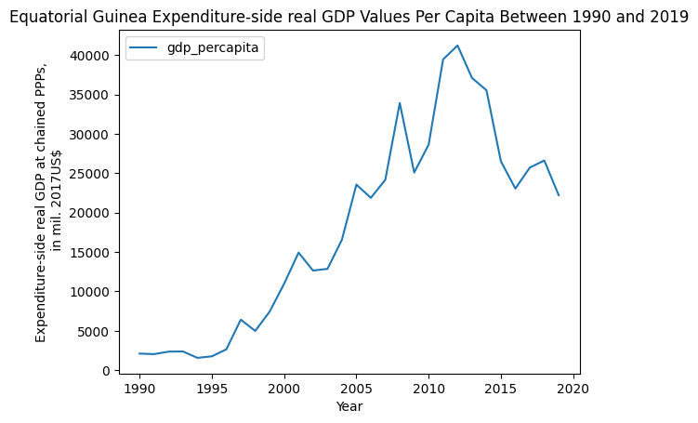
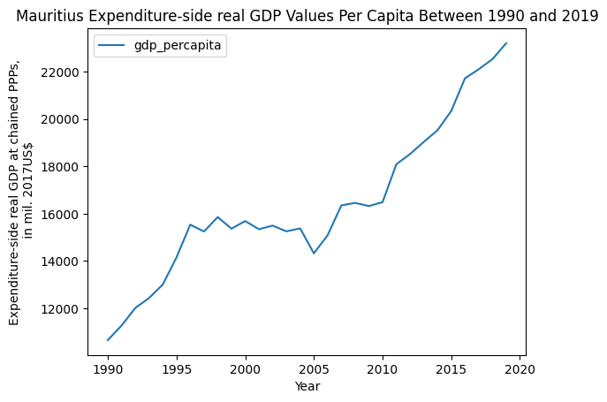
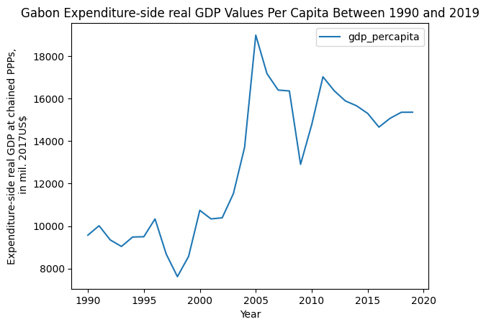
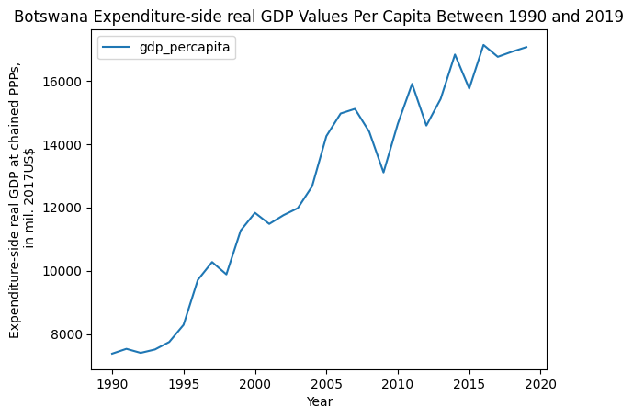
Results of GDP Analysis
Analysis of GDPs per capita produces a different set of top 5 countries. These countries are Seychelles, Equatorial Guinea, Mauritius, Gabon, and Botswana.

Slide 8
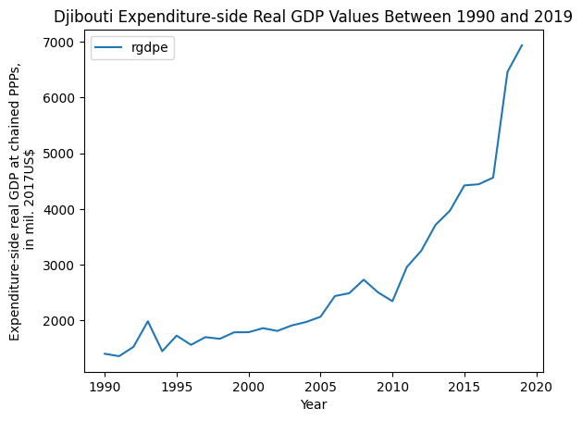
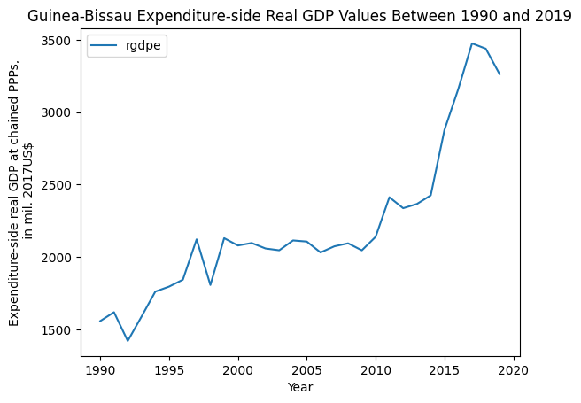
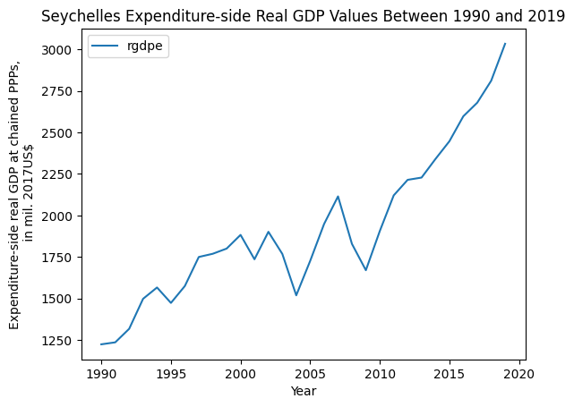
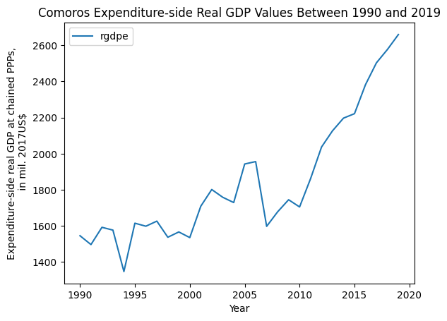
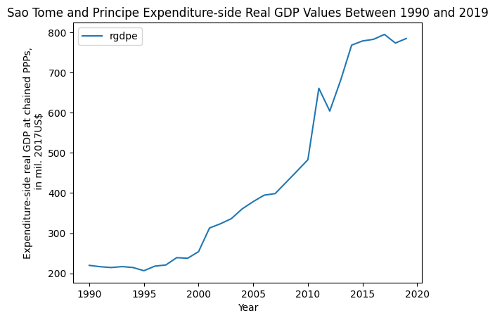
Results of GDP Analysis
The countries with the lowest average GDP over the last 30 years are Djibouti, Guinea-Bissau, Seychelles, Comoros, and Sao Tome and Principe.

Slide 9
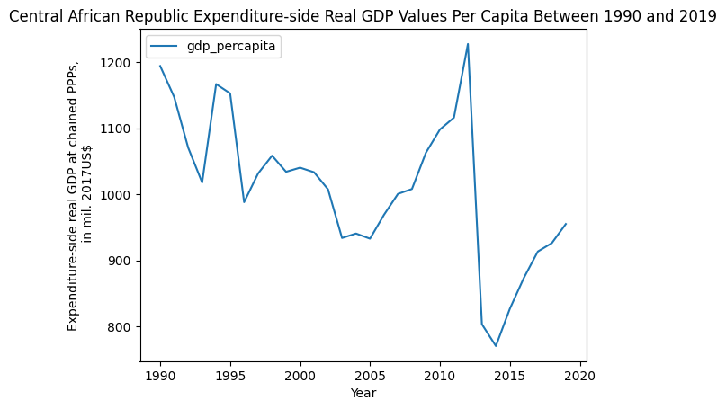
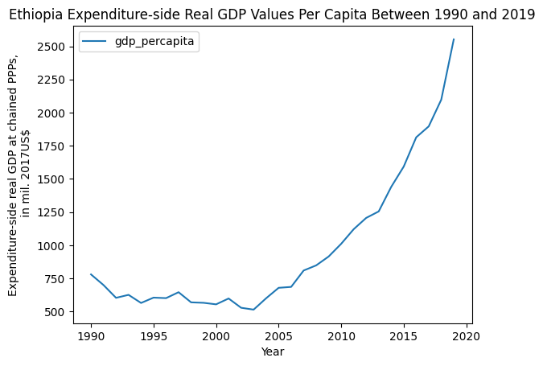
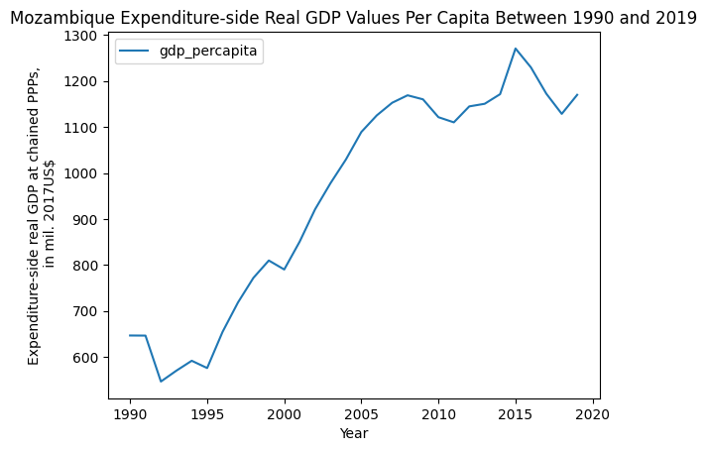
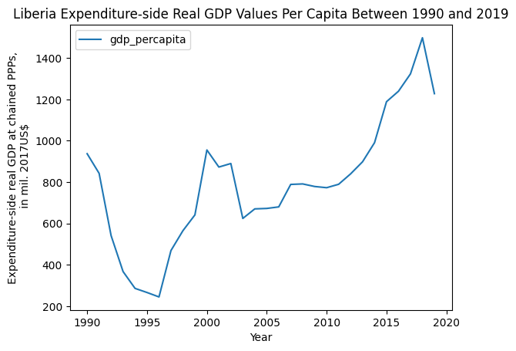
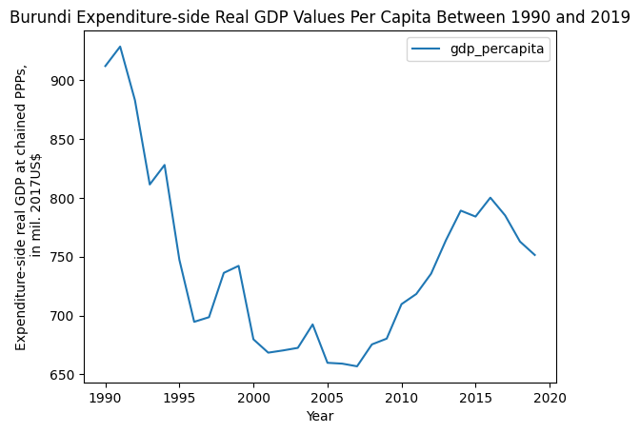
Results of GDP Analysis
The countries with the lowest GDPs per capita in the last 30 years are the Central African Republic, Ethiopia, Mozambique, Liberia, and Burundi.

Slide 10
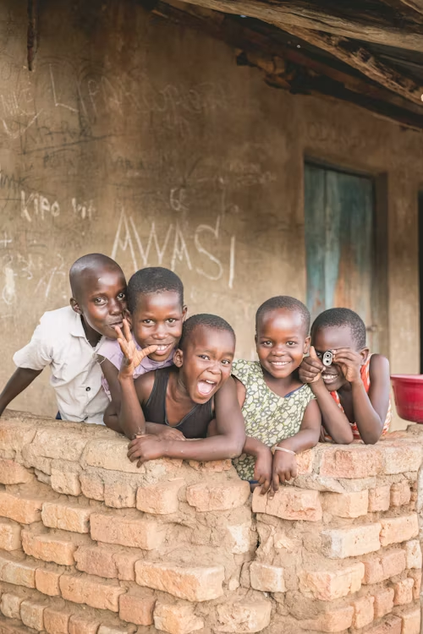
Conclusions
Analysis of the results of the Penn World data set has led us to the following conclusions:
While certain countries have had the highest GDPs over the last 30 years, these are not the countries with the highest GDPs per capita.
Likewise, the countries with the lowest average GDPs over the last 30 years are not the same as those with the lowest average GDPs per capita.
While South Africa, Egypt, and Nigeria have some of the largest economies in Africa, it may be worthwhile to draw lessons from the African countries with the highest GDPs per capita as well.

Slide 11
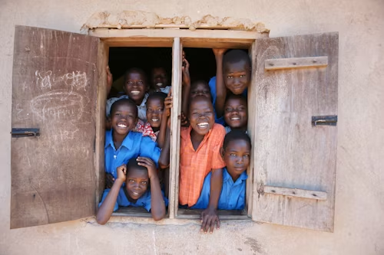
Areas for Further Study
The conclusions drawn from analysis of the Penn World data set has sparked interest in areas for further study:
Study the characteristics of the countries with the highest GDPs per capita and apply relevant characteristics to countries with similar conditions in order to improve the GDP per capita of the poorer countries.
Use the entire dataset to compare Africa’s GDPs to those of other continents. Then, use this information to provide guidance to poorer countries as discussed in point #1.

Slide 12
References
Dataset
Feenstra, Robert C., Robert Inklaar and Marcel P. Timmer (2015), "The Next Generation of the Penn World Table" American Economic Review, 105(10), 3150-3182, available for download at www.ggdc.net/pwt
Photos
Unsplash.com

Slide 13
Thank you.
For more information , please contact:
Sylvia Umegbolu
sumegbolu@gmail.com

